Slide 1
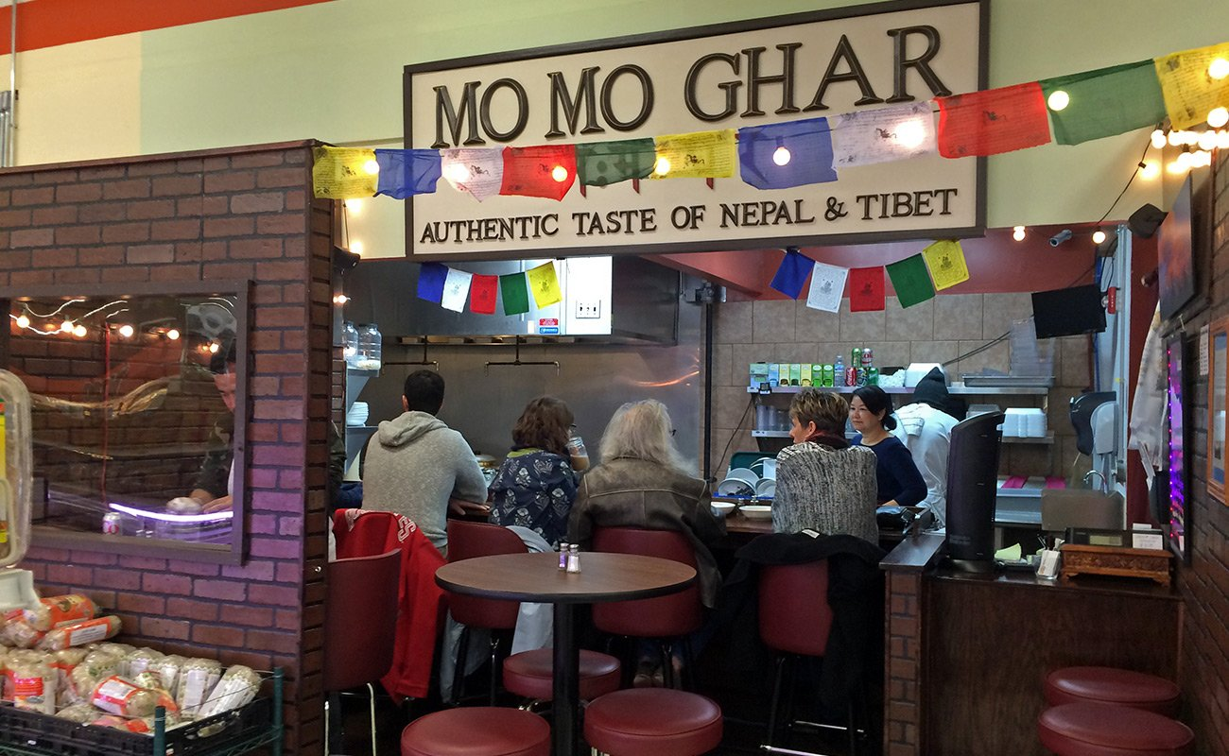
MO MO GHAR
HOME | ABOUT | MENU | LOCATION
Authentic taste of nepali & Tibitian mo mo in fukuoka,japan
Phone no:080 8577 7119

Slide 2

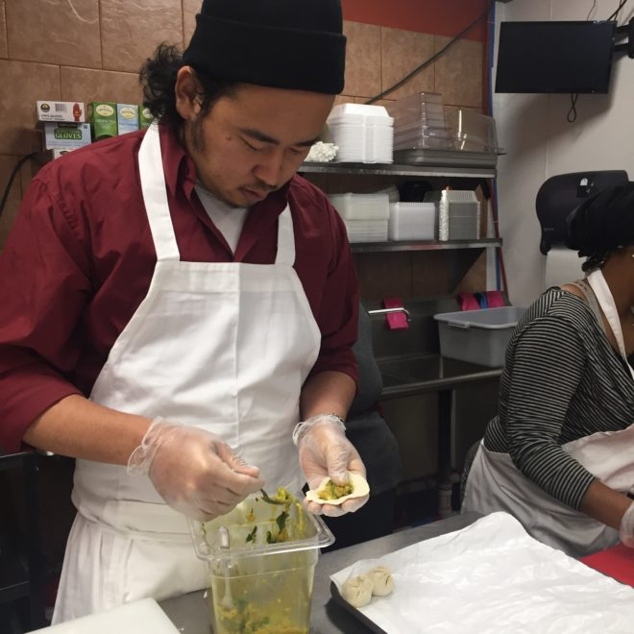
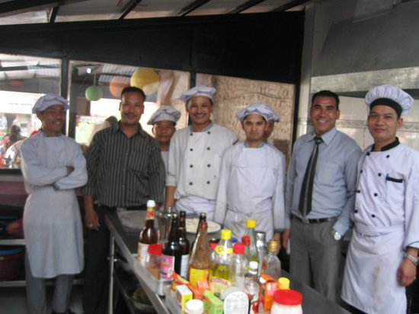
HOME | ABOUT | MENU | LOCATION
If you’re trapped into the food scene in fukuoka you’ve probably heard of MOMO Ghar.The tiny Himalayan food stall has garnerd a huge amount of press. Including top rating restaurant in fukuoka.
Momos, for the uninitiatate.are Himalayan dumpling. MOMO Ghar features a variety of steamed and fried momo from Nepal and Tibet. The main features are jhol Momo ,you’vr probably seen them popping up on insta,They’re a Kathmandu Valley style,according to bthe menu,and filled with chicken ,buff and spices, then served in a spicy broth. They’re a must try Mmos in our Resturents,so engoy our place and give a chance to serve you.

Slide 3
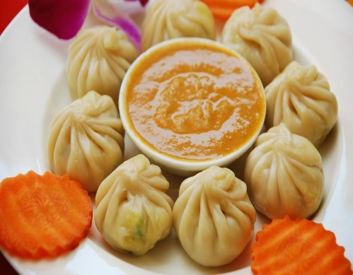
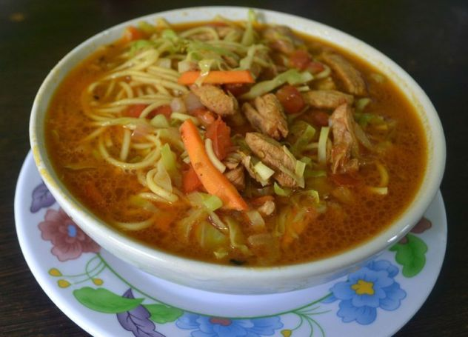
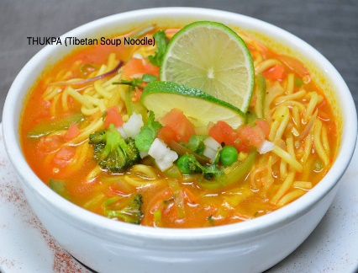
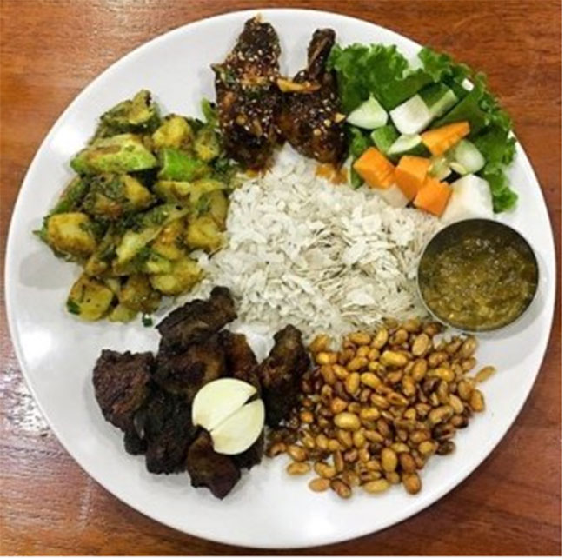
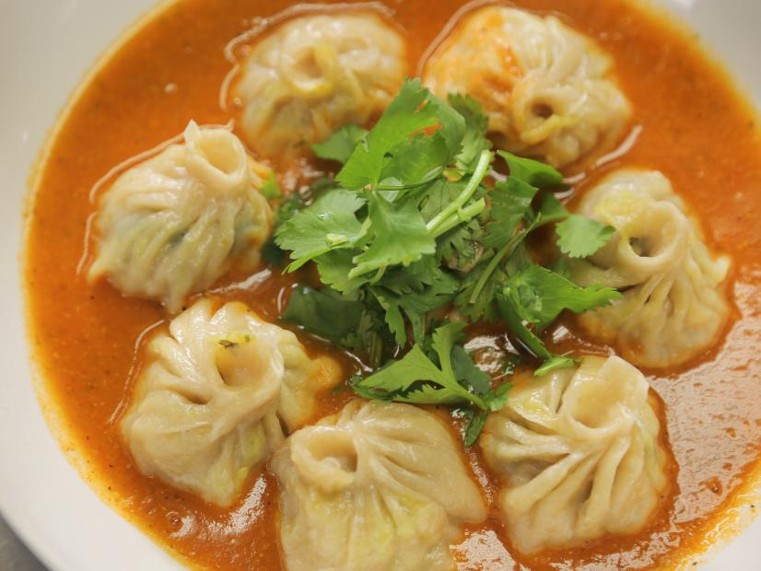
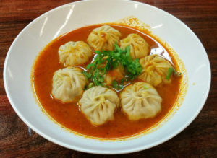

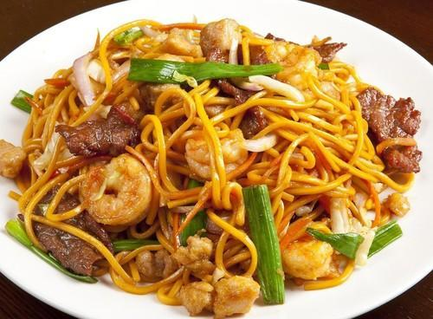

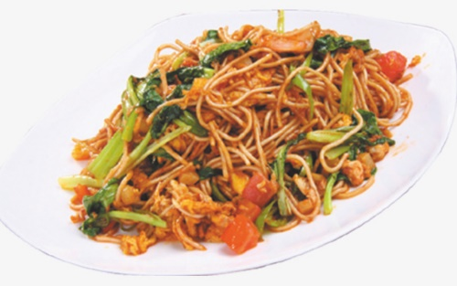
MO MO GHAR
HOME | ABOUT | MENU | LOCATION
MOMO
Buff MOMO(steam) :RS500
Buff MOMO(fried) :RS550
Chicken MOMO(steam) :RS600
Chicken MOMO(fried) :RS650
Veg MOMO(steam/fried) :RS500
Pork MOMO(steam) :RS550
Pork MOMO(fried) :RS600
THUKPA
Buff/chicken :RS500
Veg :RS500
KHAJA SET
Mixed khaja set :RS1000
DRINKS
Soft drink
Coffee :RS200
Coke :RS250
Fanta :RS250
Lassi :RS250
Hard drinks
Beer :RS500
Rum :RS3500
Whisky :RS4000
CHOWOMIN
Veg. chowomin :RS500
Chicken Chowomin :RS500
Buff Chowomin :RS500

Slide 4

HOME | ABOUT | MENU | LOCATION
MOMO GHAR is located at near to the ohashi station,it takes 2 minutes walk from the station, and have a large space for parking.
MOMO GHAR
Cont. ph .no:080 8577 7119
:080 5372 0021
Mali address:momoghar@gmail.com

